Slide 1



Edge AI and Gemini for IoT
Nitin Tiwari
Google Developer Expert – Machine Learning Senior Data Scientist at Zelar

Slide 2
$whoami
Senior Data Scientist at Zelar
Google Developer Expert in Machine Learning
Contributor to Gemini, Gemma Cookbooks, TensorFlow.js, Google Dev Library
Technical Speaker (50+ talks across India and internationally)
Write blogs on AI/ML on Medium

Slide 3
Content
What is IoT?
Architecture of an IoT System
Applications of IoT
Artificial Intelligence of Things (AIoT)
Gemini Robotics-ER 1.5
Edge AI and TinyML Frameworks
Resources for you to get started

Slide 4
What is IoT?

Slide 5
Internet of Things
Internet of Things (IoT): A network of physical objects ("things") embedded with sensors and software to connect and exchange data over the internet.
In simple terms, giving everyday objects the ability to "talk" to the internet and each other without human help.
The goal is to create a seamless network of interconnected devices that collect data, automate tasks, and provide real-time information.

Slide 6
Architecture of an IoT System

Slide 7




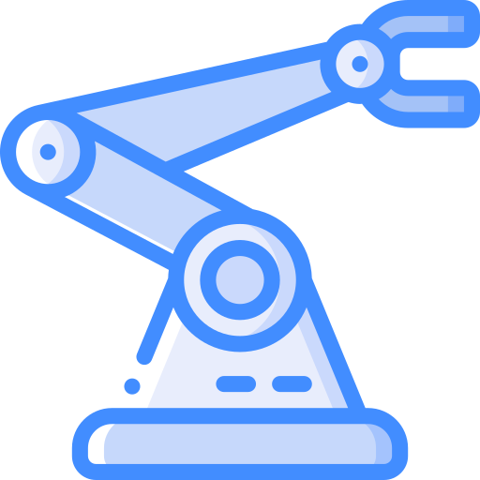


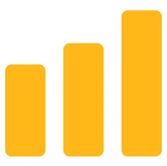
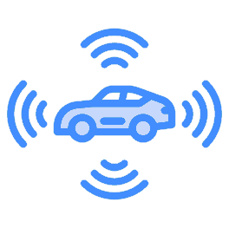
Architecture of an IoT System
A typical IoT system consists of the following blocks:
Perception Layer
Network Layer
Processing Layer
Application Layer

Slide 8
Components of IoT
Perception Layer: Physical layer with sensors and actuators that collect data from the environment.
Network Layer: Transmits the collected data through communication technologies (Wi-Fi, Bluetooth, 5G, etc.).
Processing Layer: Stores, analyzes, and processes data (on edge devices or cloud) to generate insights.
Application Layer: Provides services and interfaces for end-users (apps, dashboards, automation).

Slide 9
Applications of IoT

Slide 10
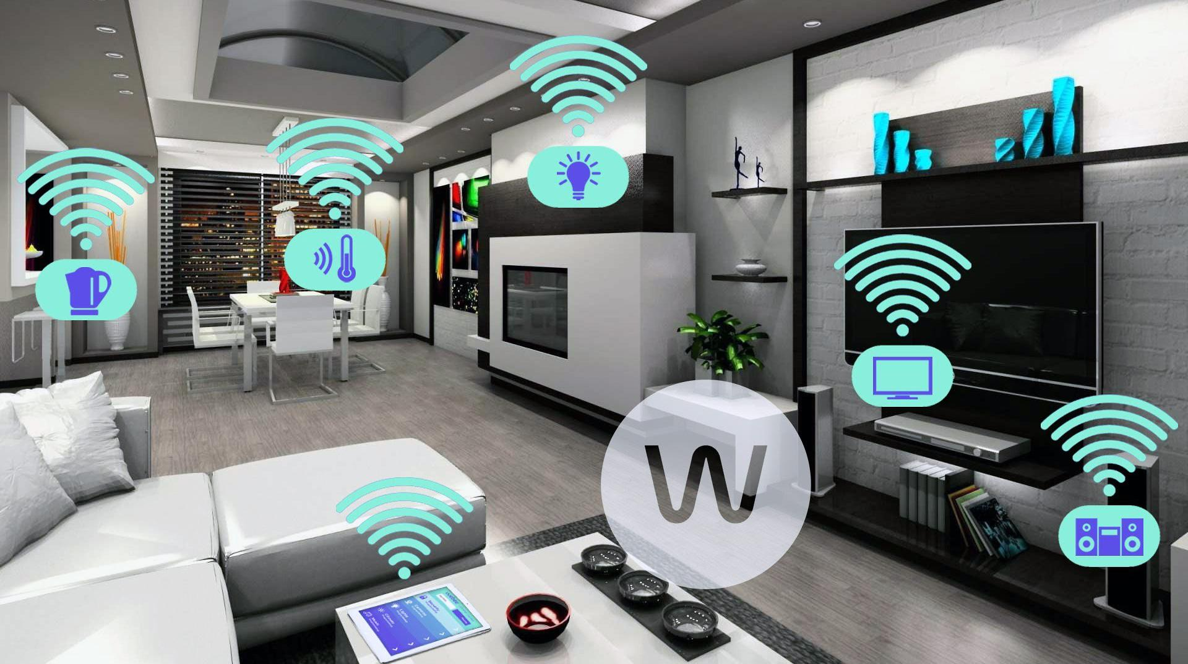
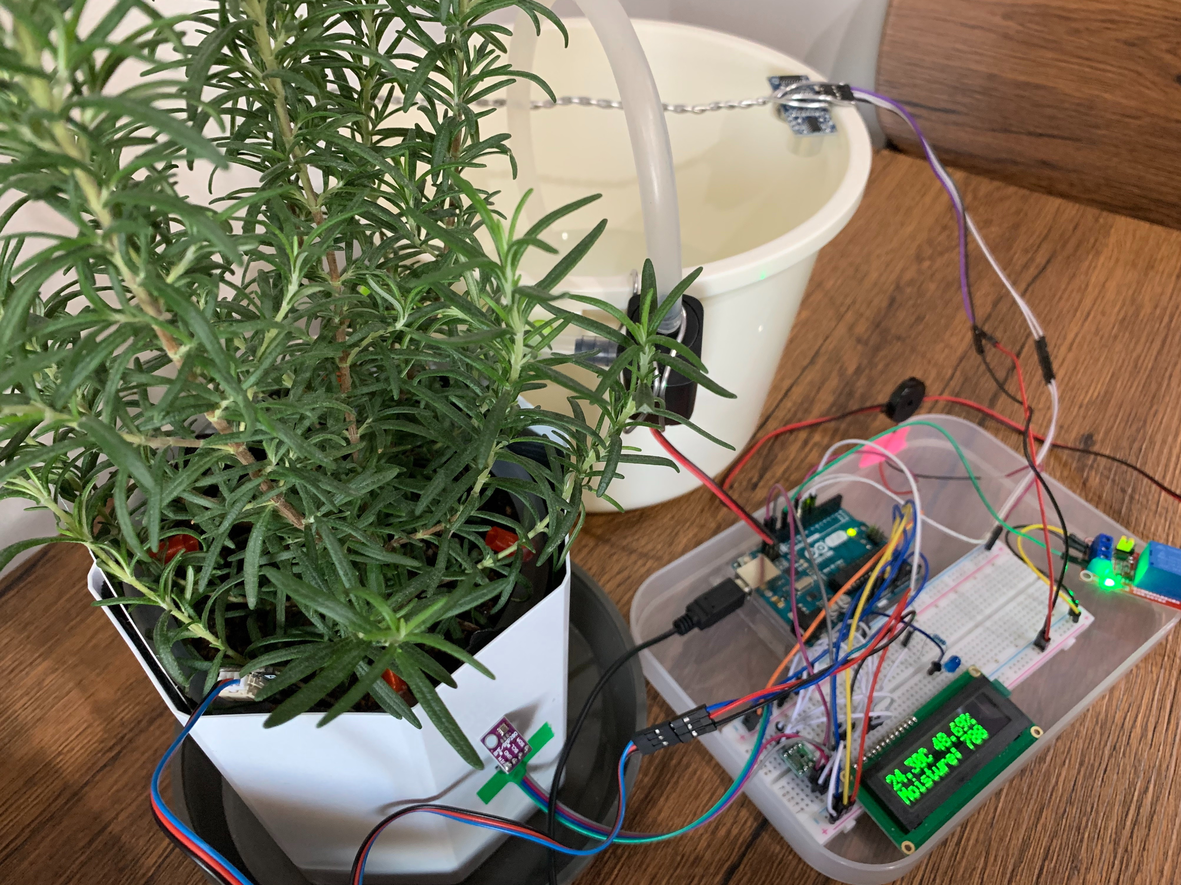
Applications of IoT
Home Automation
Smart Irrigation System

Slide 11
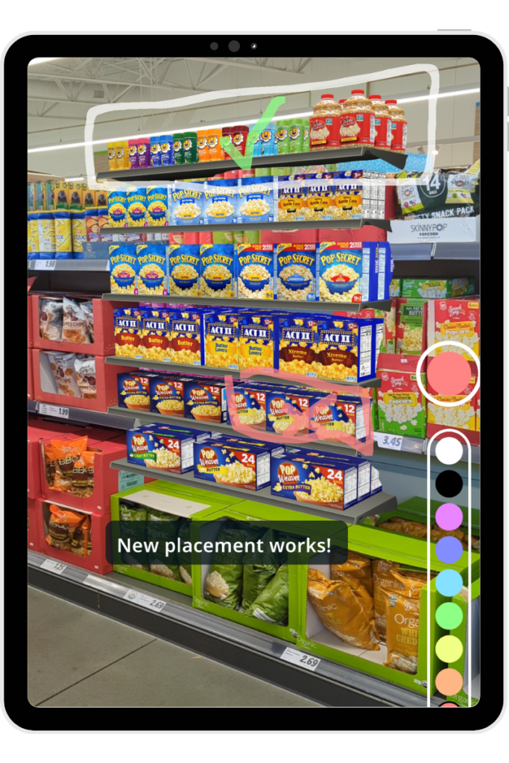
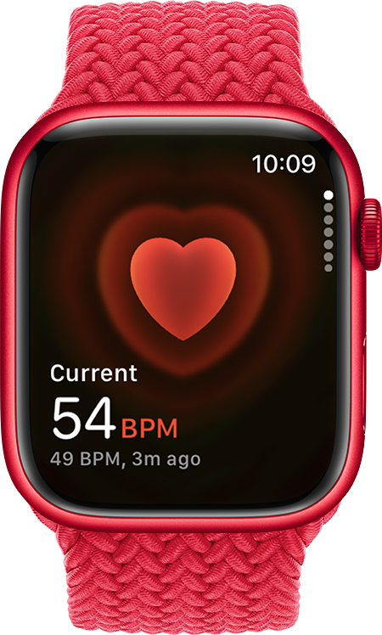
Applications of IoT
Smart Wearables
Planogram Compliance

Slide 12
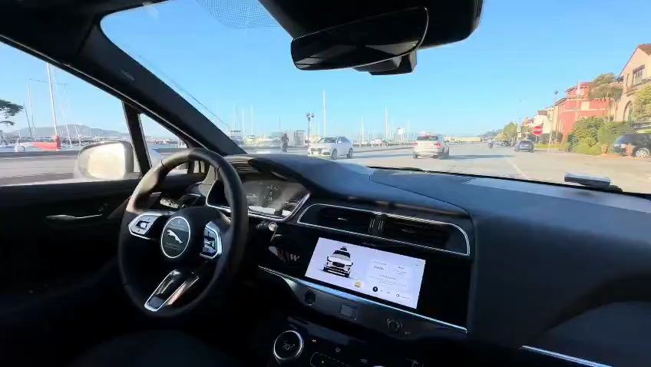
Waymo Self-driving Car
Waymo Self-Driving Car, San Francisco, USA

Slide 13
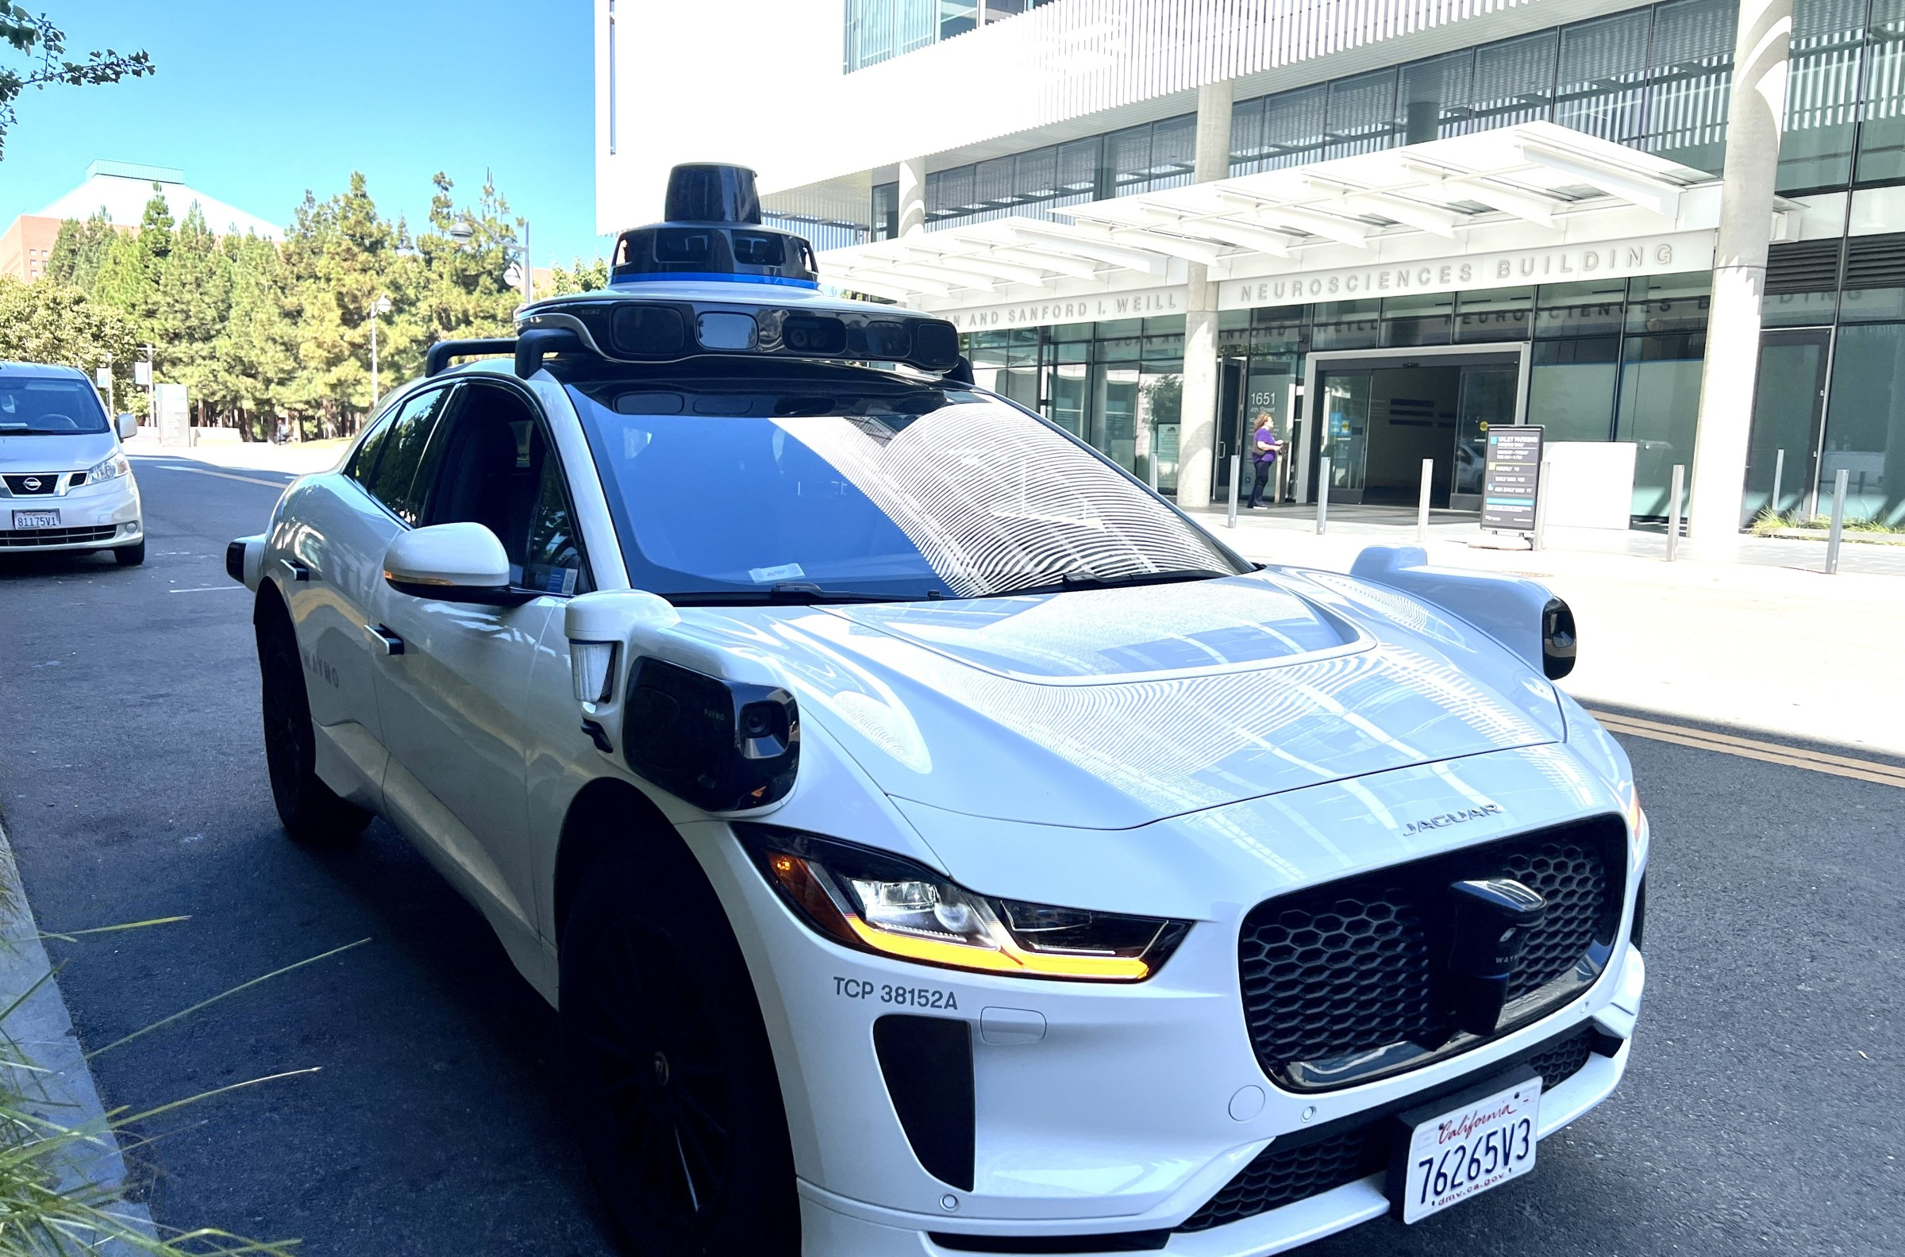
How does Waymo work?
A forward-facing camera works with 8 others stationed around the car to provide 360° vision.
LiDAR system that shoots lasers so that the car can see its surroundings
Radar sensors that can detect objects in rain, fog, or snow
Self-driving sensors integrated into the hybrid minivan

Slide 14
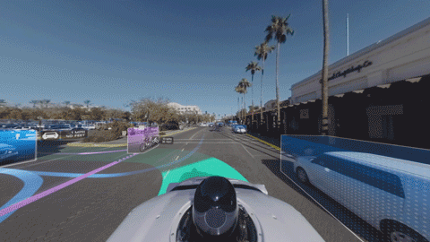
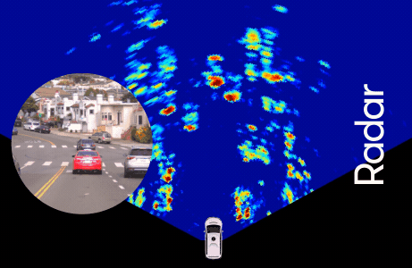
What does the Waymo car see?

Slide 15
Artificial Intelligence of Things (AIoT)

Slide 16
Artificial Intelligence of Things (AIoT)
Combining AI and IoT to make intelligent systems using Edge AI technologies.
An edge typically means smaller devices like mobiles, sensors, microcontrollers, Arduino, Raspberry Pi, etc.
Edge AI refers to running Machine Learning algorithms locally on these devices.
Small Language Models (SLMs) are also used in many on-device applications like smart watches that understand voice queries, and AI voice assistants like Alexa, Google Assistant, etc.

Slide 17
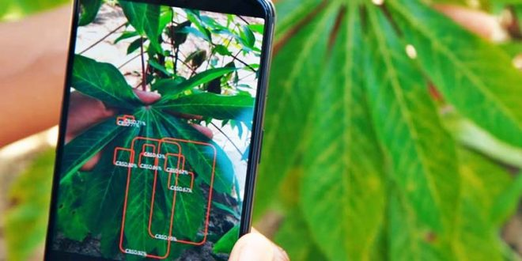
Example – Edge AI
Object Detection on mobile using LiteRT (formerly TensorFow Lite)

Slide 18


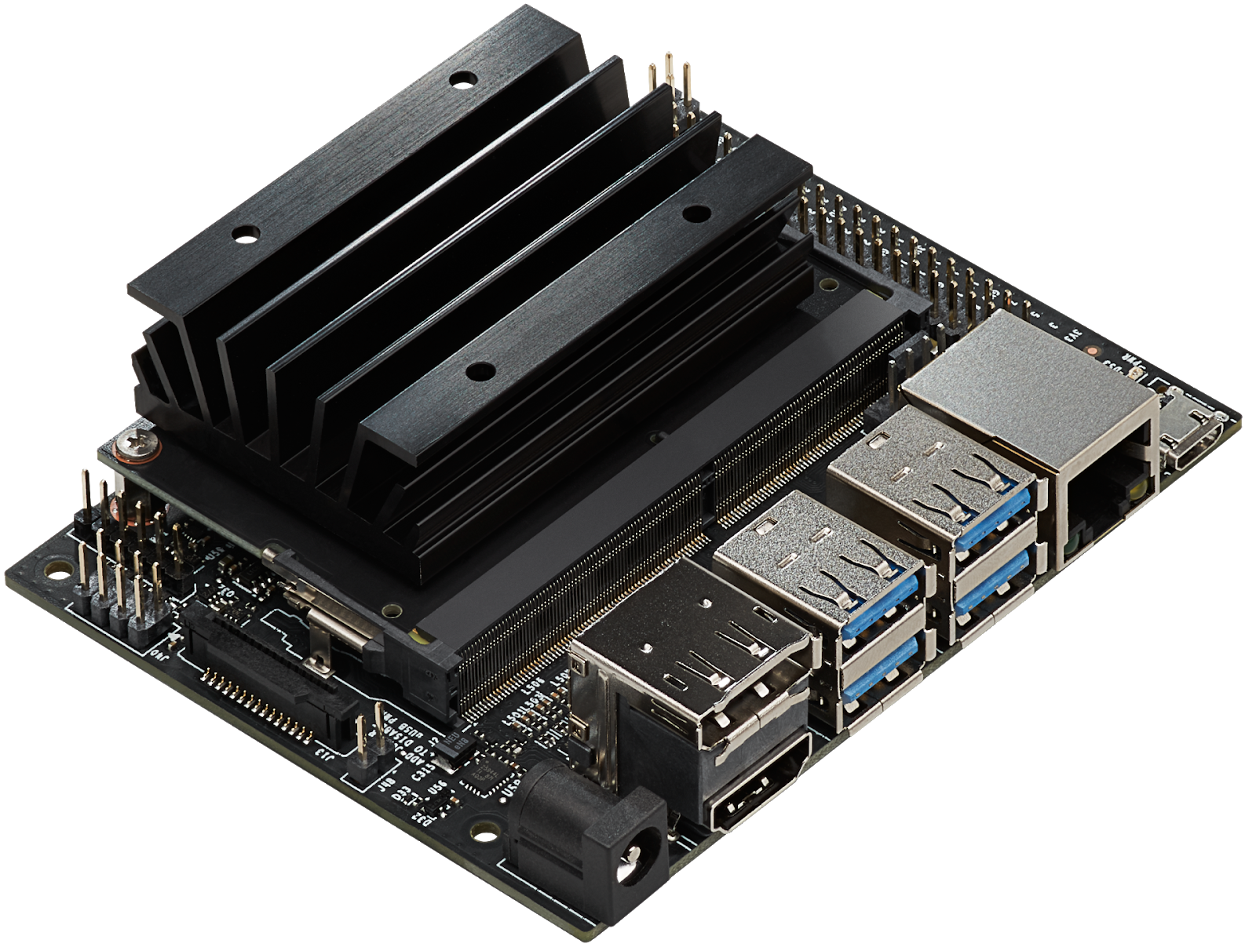
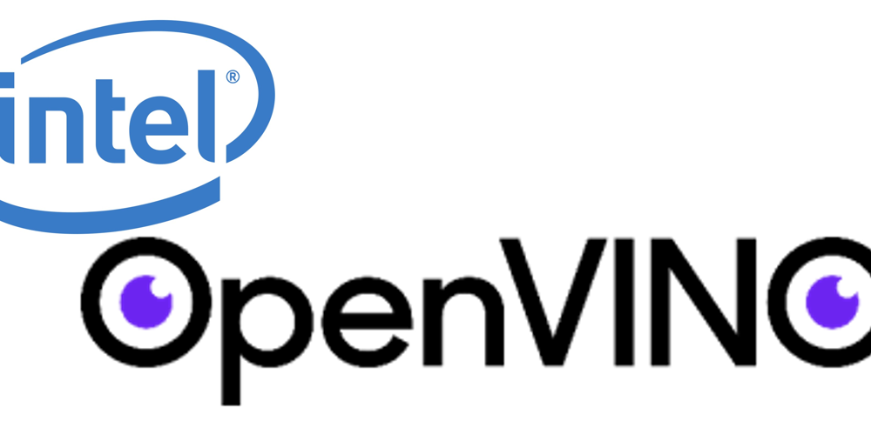
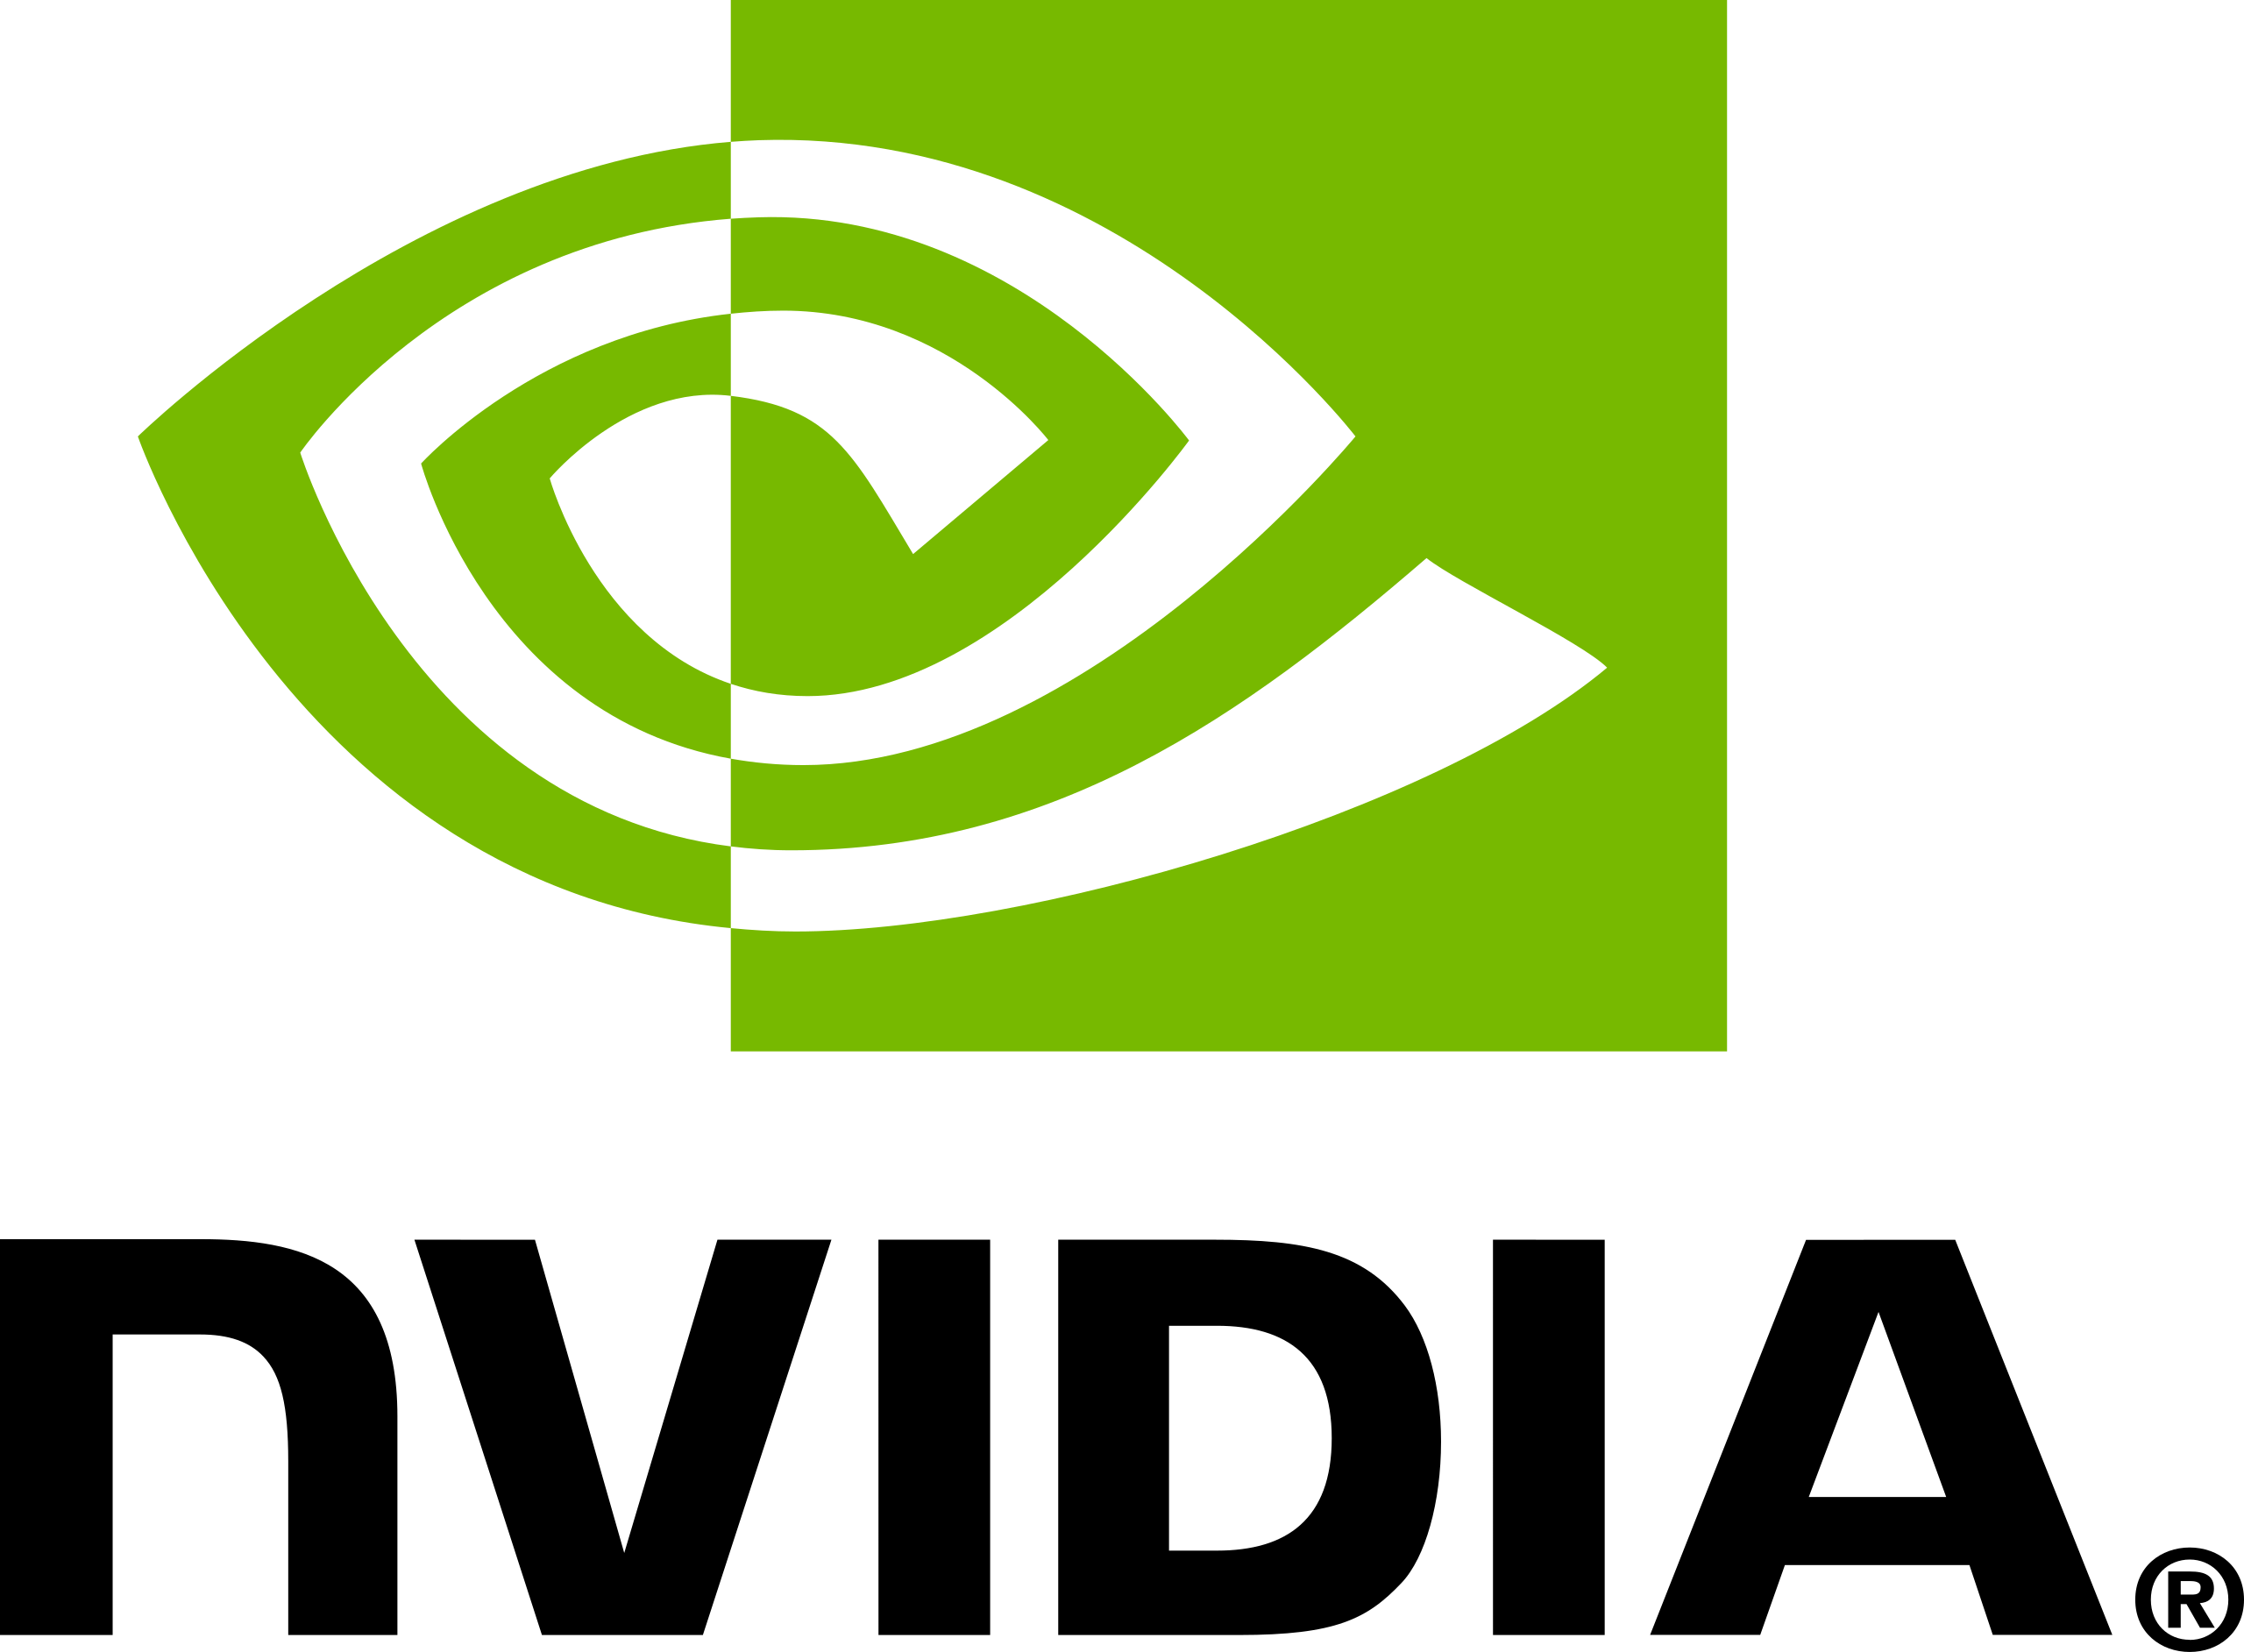
Edge AI & TinyML Frameworks
Lighter version of TensorFlow for mobile and edge devices
Enables deployment of PyTorch models on edge devices
NVIDIA Jetson Nano for computer vision, robotics, autonomous systems
Optimize Deep Learning models for Intel CPUs, GPUs at the edge

Slide 19
Gemini Robotics-ER 1.5

Slide 20
Gemini Robotics-ER 1.5
Gemini Robotics-ER 1.5 is a vision-language model (VLM) designed to give robots advanced reasoning and planning capabilities in the physical world.
It functions as the "high-level brain" for a robot, taking natural language commands and creating detailed plans by interpreting visual data, performing spatial reasoning, and calling external tools, like search engines, to execute complex, multi-step tasks such as cleaning a table or sorting objects.

Slide 21
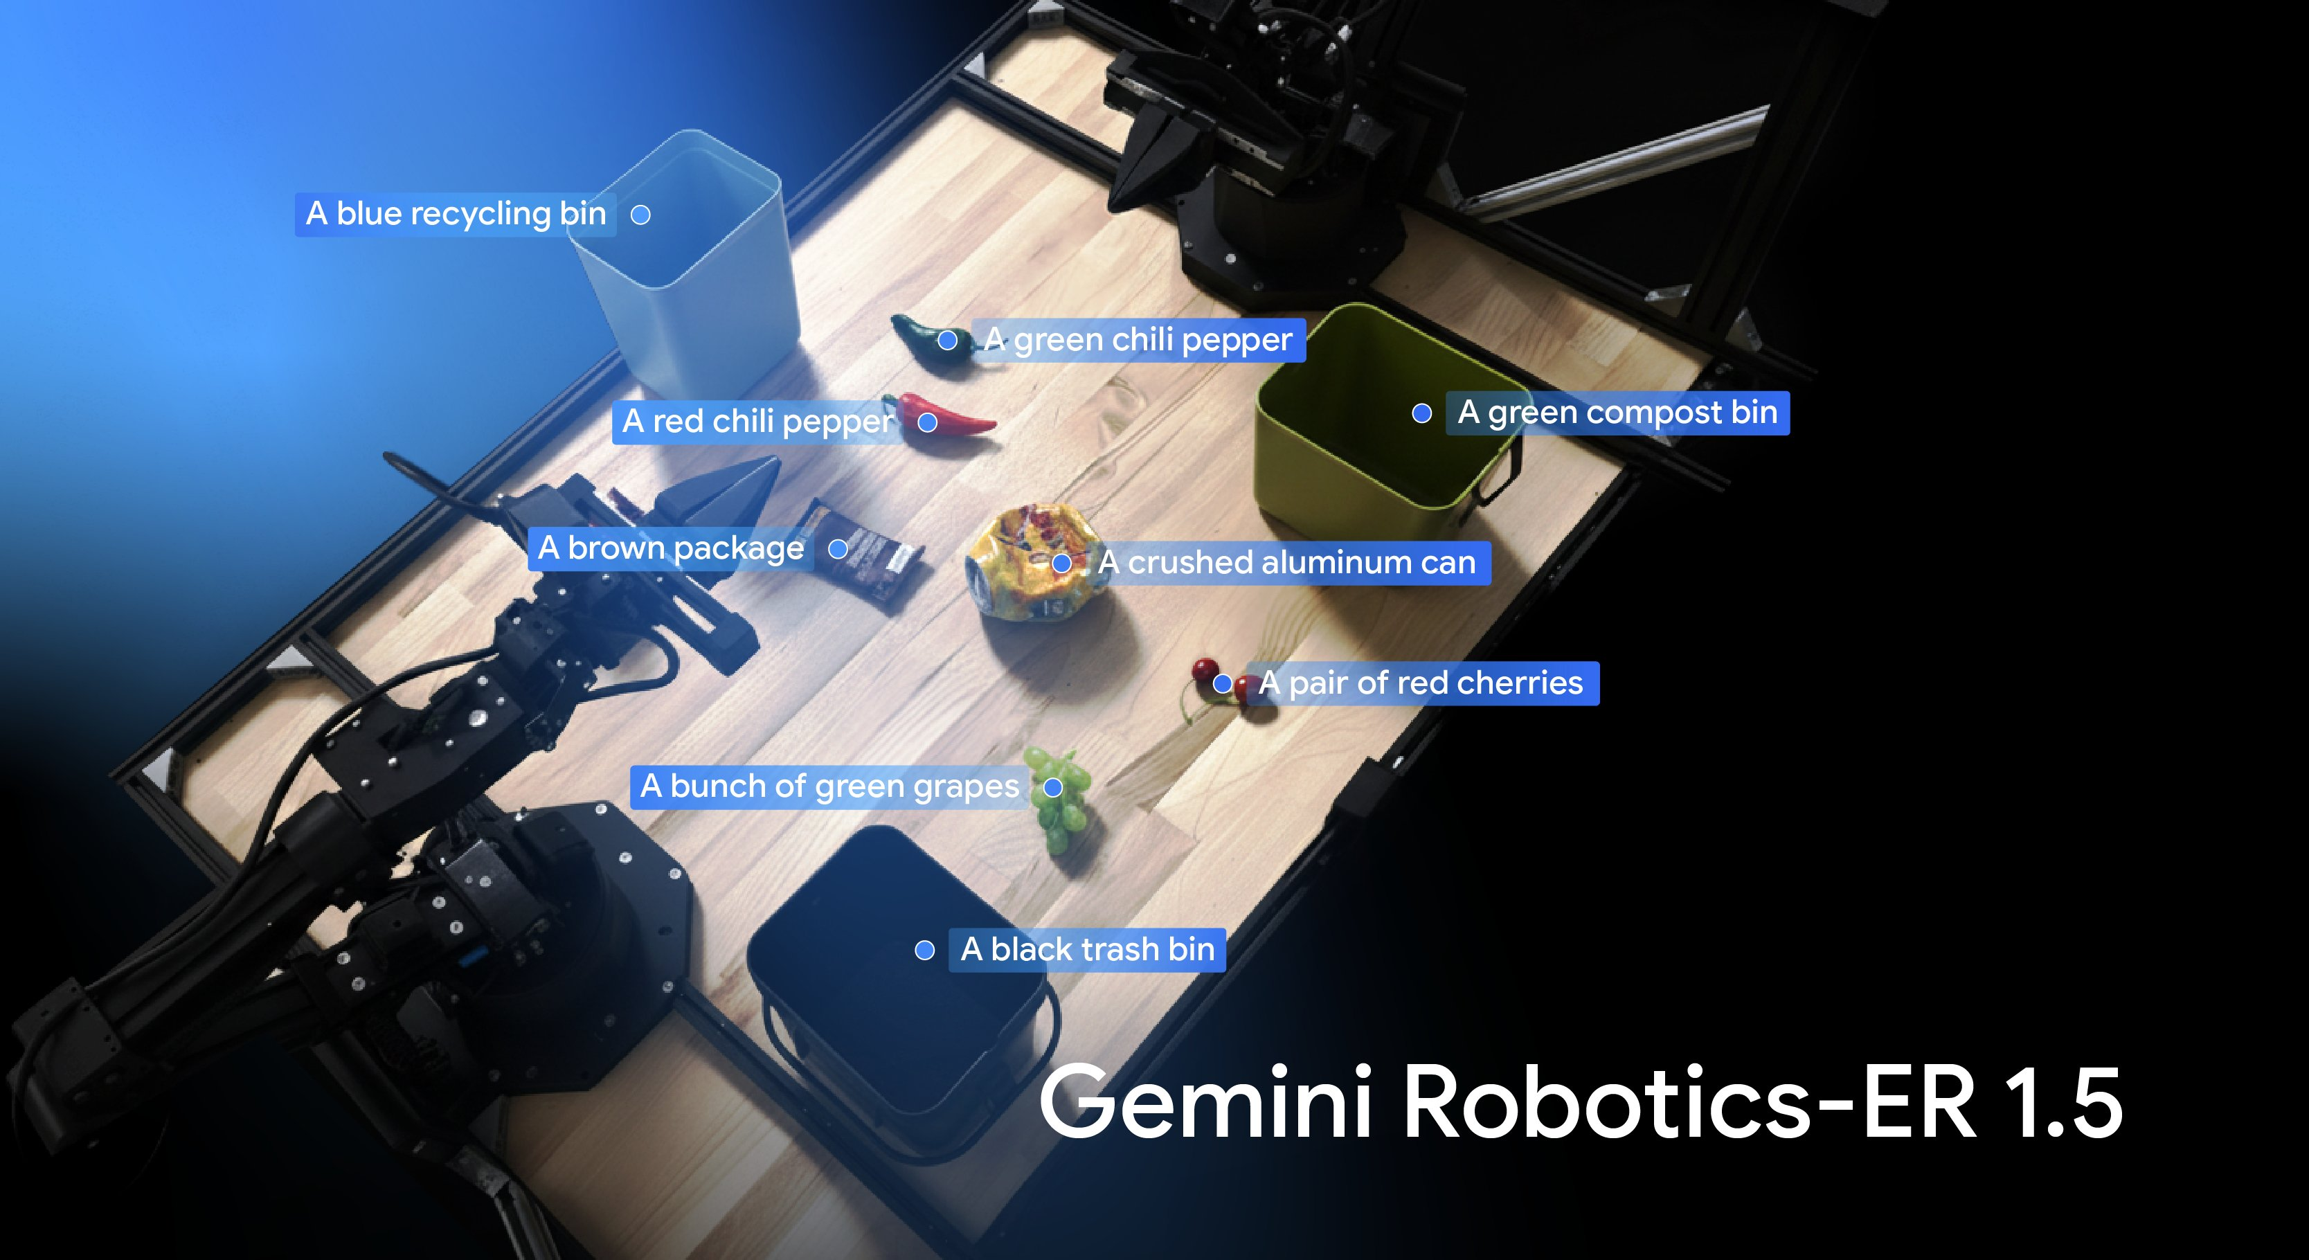
Gemini Robotics-ER 1.5

Slide 22
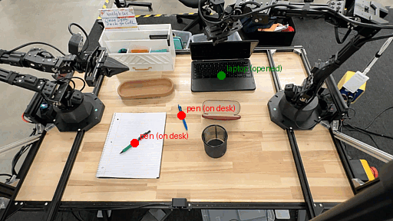
Gemini Robotics-ER 1.5 in action

Slide 23
Resources

Slide 24
Resources
Gemini Robotics-ER 1.5: https://ai.google.dev/gemini-api/docs/robotics-overview
TensorFlow Lite (LiteRT) for Edge AI: https://www.tensorflow.org/lite
Edge Impulse for TinyML and Edge AI: https://edgeimpulse.com/
Small Language Models overview and applications: https://www.ibm.com/think/topics/small-language-models
Awesome Edge AI resources (GitHub): https://github.com/crespum/edge-ai
Getting started with TinyML on ESP32 tutorial: https://www.teachmemicro.com/tinyml-with-esp32-tutorial/

Slide 25
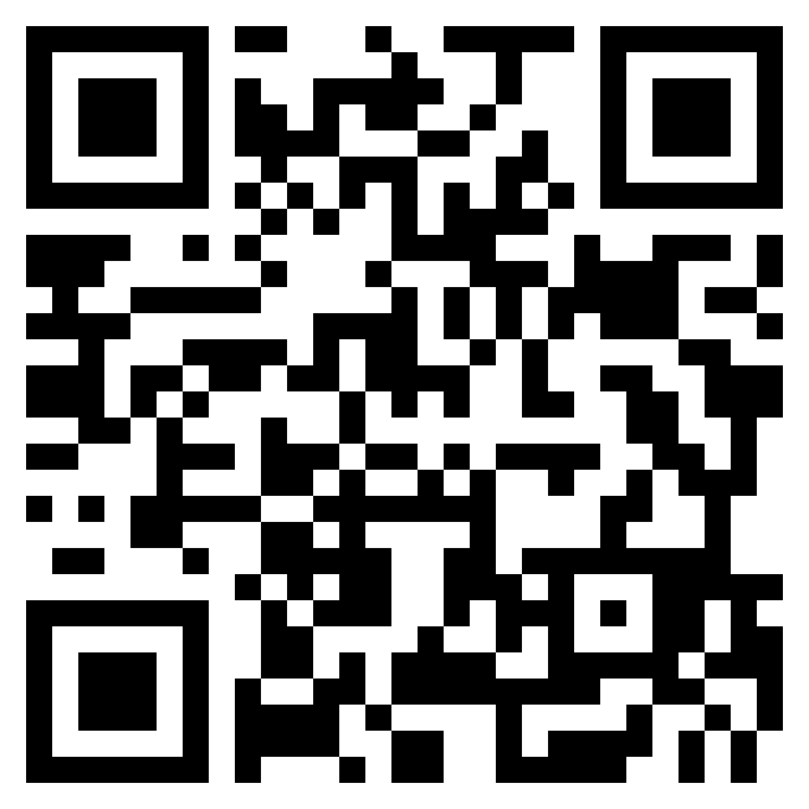




Thank You.
linkedin.com/in/tiwari-nitin
medium.com/@tiwarinitin1999
twitter.com/@NSTiwari21
github.com/NSTiwari

